Slide 1

Dr. D. Y. Patil Pratishthan’s D. Y. Patil Institute Of Master Of Computer Applications And Management Sector No. 29, Behind Akurdi Railway Station, Pradhikaran, Nigdi, Pune - 411044 FYMCA SEMISTER – 1 (2022-2023) PROJECT SYNOPSIS ON “MUSICAL INSTRUMENTS SYSTEM” Under the Guidance of: Submitted By: 1. PROF. VANITA PATIL MAM 1. DHANANJAY MANIK BHAGAT (FYMCA-149). 2. PROF. NISARGA SABALE MAM 2. ANIKET SUJIT MARGANE (FYMCA-143).

Slide 2
INTRODUCTION
The project “MUSIC INSTRUMENTS SYSTEM” is an offline windows based application designed to manage all purchase, sales related operations within an organisation.
The main objective of the application is to automate the existing system of manually maintaining the records of the product, customer, vendor, shop, purchase, sales details etc.
In this project once the information is inputted, it will provide quick information regarding data.
The new system will increase data accuracy, make music instrument shop management more secure, effective, convenient and accessible and begin to coordinate information across the system.
It gives a brief look of the products being purchased from the vendor and the products being sold to the customer and reports are generated accordingly

Slide 3
Scope of the Project
The main scope of our Music Instrument Shop Management is that, it’s a user-friendly application.
Secure registration and profile management facilities for customer.
Easy and Quick access to particular product and services.
This project is used to give maximum information to the user about product purchased from vendor and product sold to the customer, purchase and sales details etc.
This project is very convenient for the user as it minimizes the process work as well as the tedious job.
User can view different categories of product of different brands at a single place.
Data approach and access made easier and convenient as it provides easy and quick access to particular product and services.
Time required for accessing any detail will be very less. Hence the system saves time, efforts and cost.

Slide 4
Existing System
Present System is totally depending on manual data management for different activities such as maintaining details of the product, customer, vendor etc.
They maintain different register for various activities such as storing and searching data which is tedious and time-consuming task.
In present system all transactions are done manually with pen and paper.
So, the frequent updating is not possible also generating reports, accurately is not possible with current system.
Existing system is lacking in facilities such as searching, deleting, and updating data efficiently and effectively.

Slide 5
Proposed System
Our proposed system is computer-based application which provides various interfaces for various operation and hence flexible.
Provide greater speed and reduced time consumptions.
Locate any instruments information wanted by the user.
The system is able to generate calculations, reports automatically.
Operation such as adding, deleting/ removing, searching, updating customer details, vendor details, product details, shop details, purchase details, sales details can be done efficiently and effectively by proposed system.
This application contains a secure login wherein only the authorized person can access it.
Storage and retrieval of data from the database is easier as all the information is stored in a central database.
In short proposed system is user-friendly.

Slide 6
Modules
Administration Management
Product Management
Customer Management
Vendor Management
Shop Management
Bill Management
Report Generation
Purchase Details
Sales Details

Slide 7
Requirements
Hardware Requirements:
Processor: Intel i3 10th Generation & above.
Hard Disk: 25 GB Minimum.
RAM: 1 GB Minimum.
Software Requirements:
Operating System: Windows 7 and Higher Version.
Front – End : Java Servlet/JSP, Bootstrap, HTML, JavaScript.
Back – End : Java
Server Used : Apache Tomcat
Database: MySQL.
Editor: NetBeans, Eclipse IDE

Slide 8
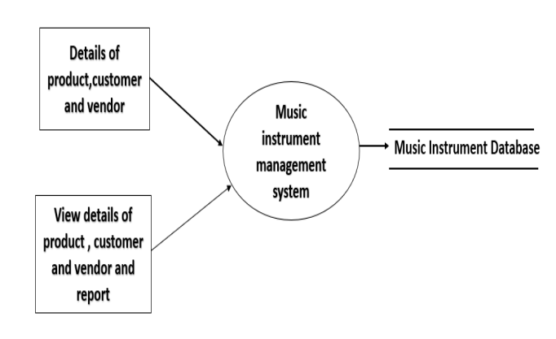
DATA FLOW DIAGRAM: -
Level 0 :

Slide 9
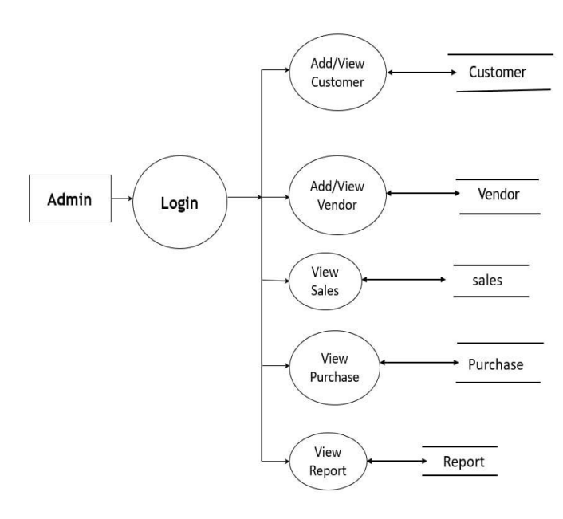
Level 1 :

Slide 10
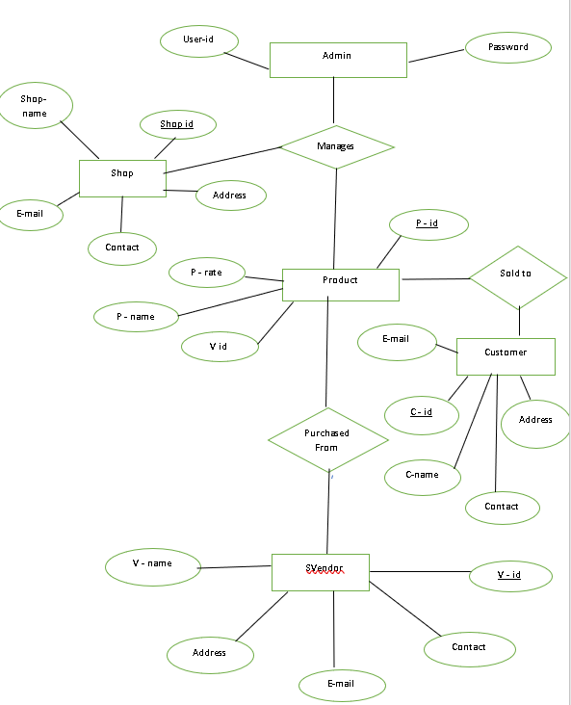
ENTITY RELATIONSHIP DIAGRAM :-

Slide 11
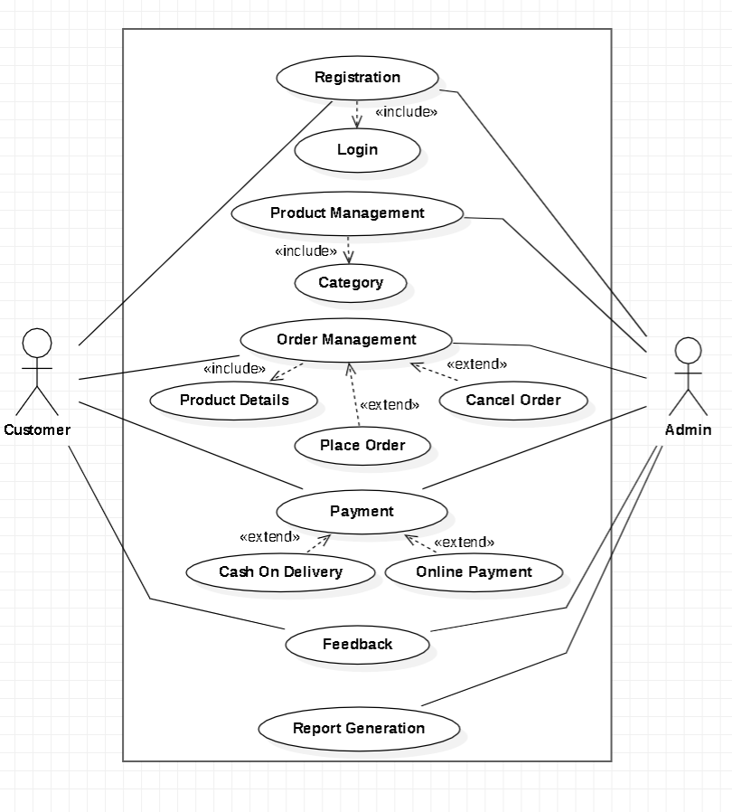
USE CASE DIAGRAM :-

Slide 12
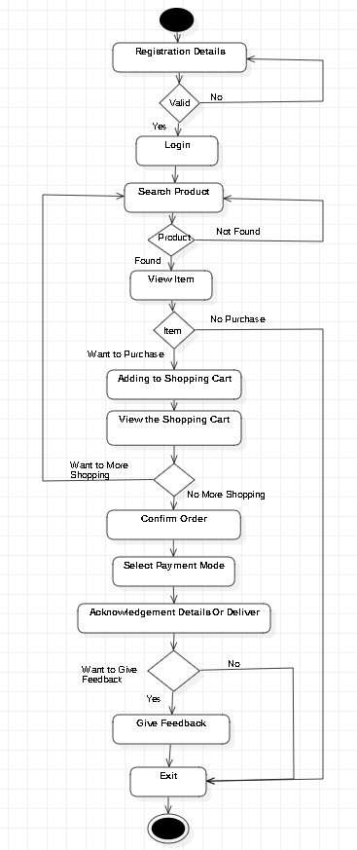
ACTIVITY DIAGRAM :-

Slide 13
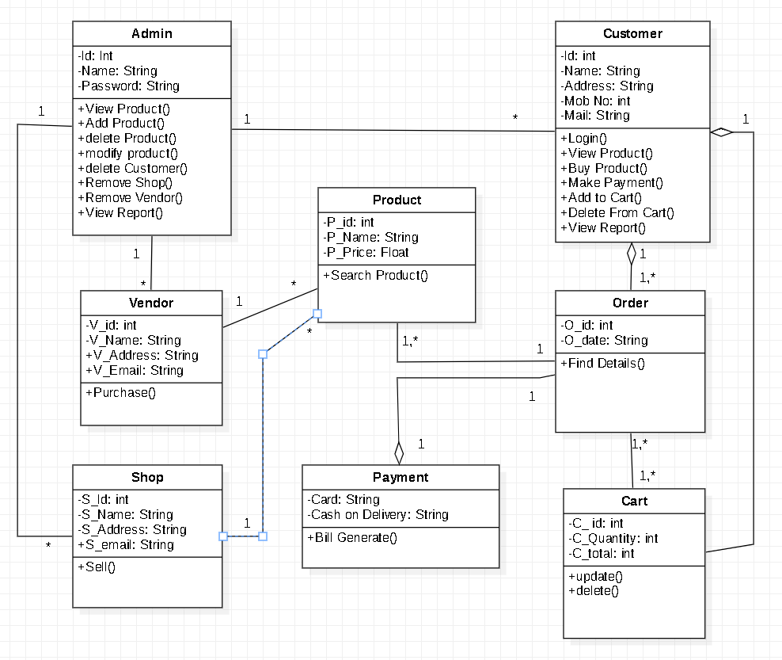
CLASS DIAGRAM :-

Slide 14
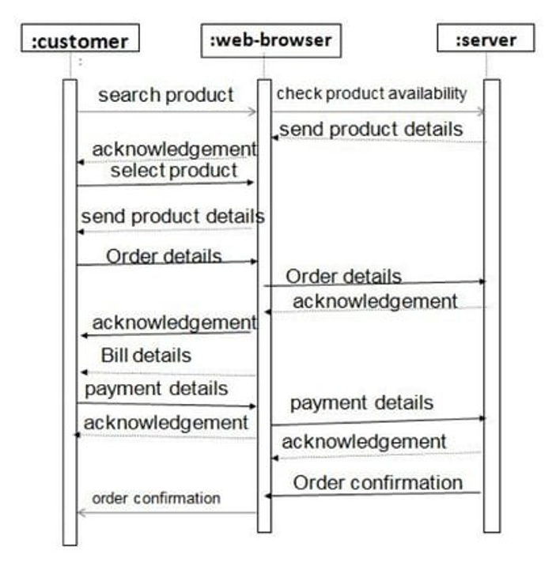
Sequence Diagram :-

Slide 15
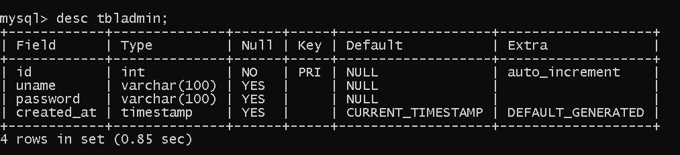
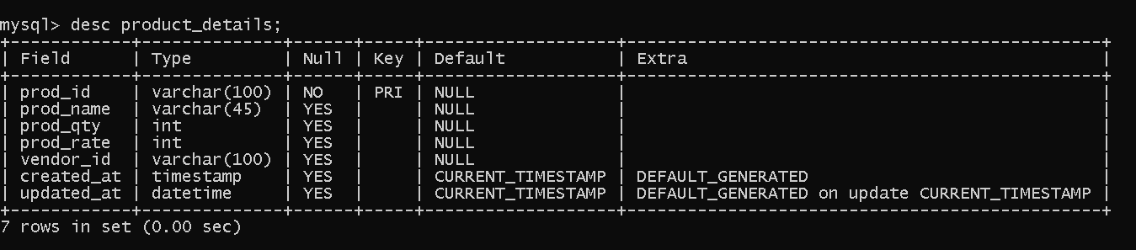
Table Structure :-
Admin Table
Product Detail Table

Slide 16
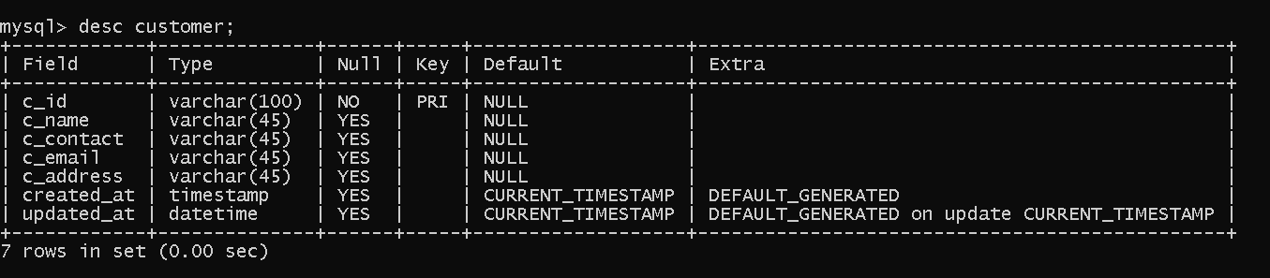
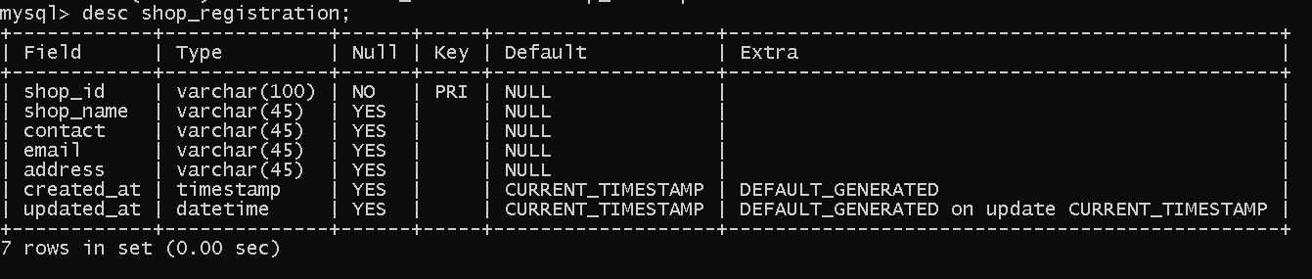
Customer Table
Shop Details Table

Slide 17
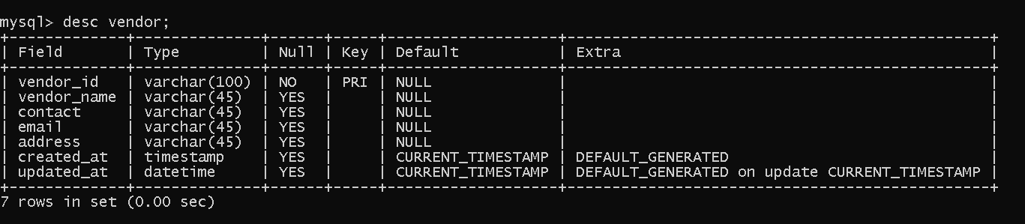
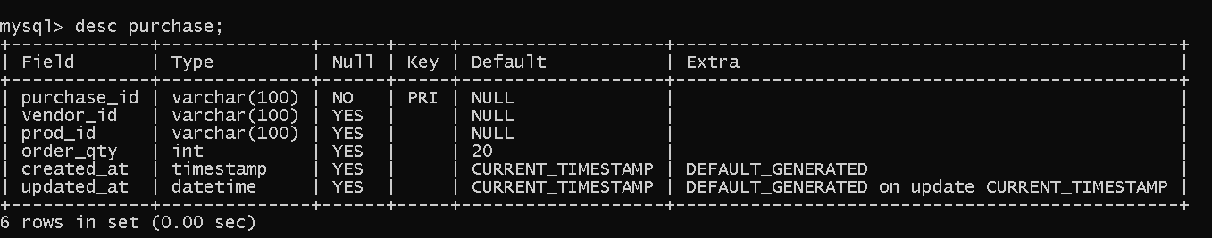
Vendor Table
Purchase Table

Slide 18
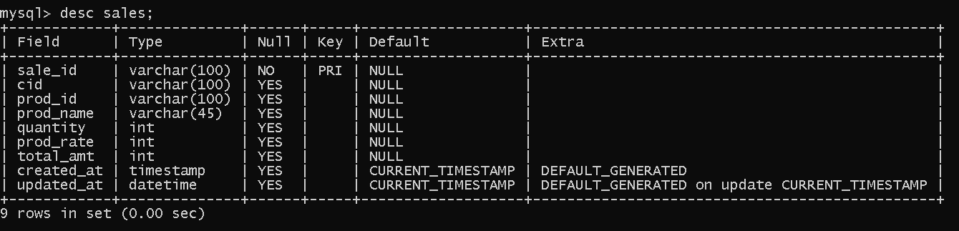
Sales Table

Slide 19
THANK YOU

